Slide 1
AtliQ hardware sales insights
Power BI Sales Insights project
Intermediate Level
Data Analysis and Data Visualization
Dharmindar Ram Linkedin Portfolio Github E-mail

Slide 2
Key Skills practised:
AtliQ Hardware Sales Insights
MySQL(WHERE clause, AND operator, GROUP BY, INNER JOIN, ORDER BY, DESC, COUNT)
Data Analysis(analysis for a comprehensive view)
ETL(Extract, Transform and Load)
Power BI Dashboard Report(visualizations)
Business Insights
Dharmindar Ram Linkedin Portfolio Github E-mail

Slide 3
Project Purpose:
AtliQ Hardware Sales Insights
Analyze data and create a dashboard using Power BI for the stakeholder to understand top business insights.
Dharmindar Ram Linkedin Portfolio Github E-mail

Slide 4
About Project:
AtliQ Hardware Sales Insights
The project is about data analysis for sales insights of AtliQ Hardware in India. Perform data analysis on the given data and generate insights using charts for different revenue trends, customers behaviour and top performing products etc.
Dharmindar Ram Linkedin Portfolio Github E-mail

Slide 5
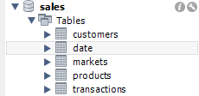
About Data:
AtliQ Hardware Sales Insights
As for this project, I've followed Mr. Dhaval Patel who is Senior Data Analyst, he provided a MySQL dump file which contains 5 tables(customers, date, markets, products and transactions) and each table contains different records. Due to privacy reasons data can't be shared publically.
Dharmindar Ram Linkedin Portfolio Github E-mail

Slide 6
Approach Used:
AtliQ Hardware Sales Insights
Data Analysis using MySQL
Data Modelling(Used Star Schema modelling type to build connection between tables based on common entities.)
ETL
Extracted data into Power Query Editor
Transformed data
Loaded transformed data to Power BI for dashboard creation
Dashboard Report Creation
Dharmindar Ram Linkedin Portfolio Github E-mail

Slide 7
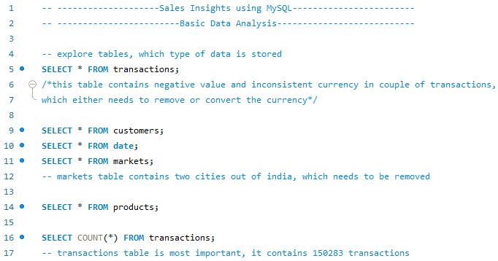
1. Data Analysis using MySQL
AtliQ Hardware Sales Insights
Data exploration through different tables.
Dharmindar Ram Linkedin Portfolio Github E-mail

Slide 8
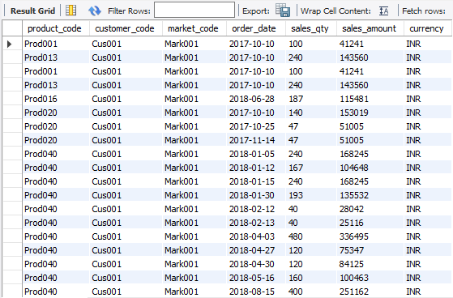
1. Data Analysis using MySQL
AtliQ Hardware Sales Insights
Print transactions were made in Chennai?
Note: each market has it’s unique code.
Dharmindar Ram Linkedin Portfolio Github E-mail

Slide 9

1. Data Analysis using MySQL
AtliQ Hardware Sales Insights
How many transactions are there with the currency USD?
Dharmindar Ram Linkedin Portfolio Github E-mail

Slide 10
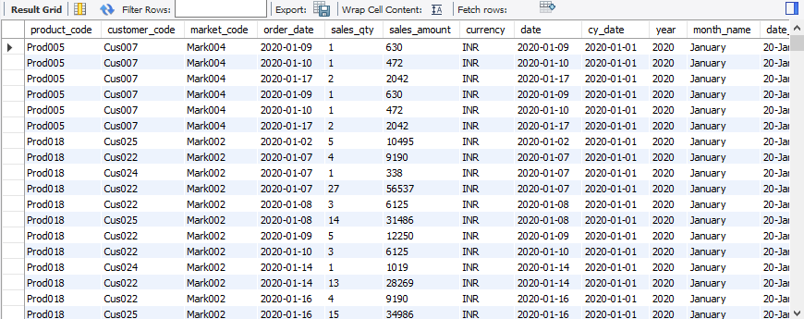
1. Data Analysis using MySQL
AtliQ Hardware Sales Insights
Print the transactions made in January 2020?
Dharmindar Ram Linkedin Portfolio Github E-mail

Slide 11


1. Data Analysis using MySQL
AtliQ Hardware Sales Insights
What is the total revenue of 2019?
Dharmindar Ram Linkedin Portfolio Github E-mail

Slide 12


1. Data Analysis using MySQL
AtliQ Hardware Sales Insights
Show the revenue made in Chennai in 2020?
Dharmindar Ram Linkedin Portfolio Github E-mail

Slide 13
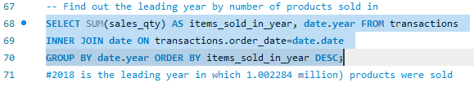
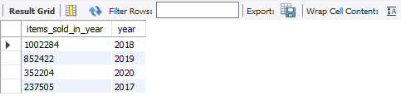
1. Data Analysis using MySQL
AtliQ Hardware Sales Insights
Find out the leading year by number of products sold in?
Dharmindar Ram Linkedin Portfolio Github E-mail

Slide 14

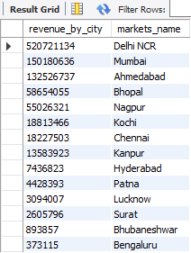
1. Data Analysis using MySQL
AtliQ Hardware Sales Insights
Which market is leading by revenue
Dharmindar Ram Linkedin Portfolio Github E-mail

Slide 15
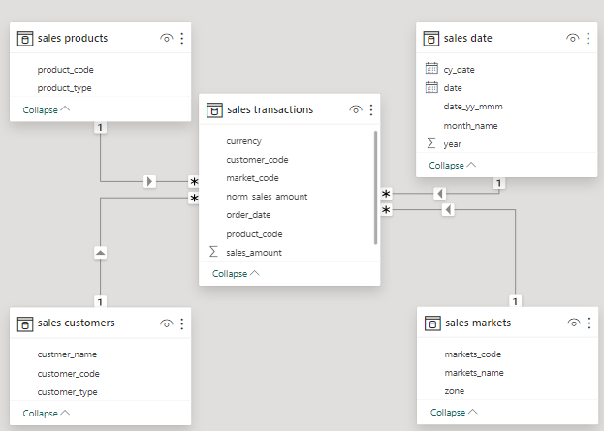
2. Data modelling
AtliQ Hardware Sales Insights
Established relation between tables based on common entities.
Dharmindar Ram Linkedin Portfolio Github E-mail

Slide 16
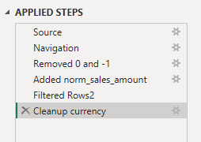
3. Data transformation
AtliQ Hardware Sales Insights
Transformed data, filtered out 0s and -1s as sales_amount, added new
Column for normalized currency etc.
Dharmindar Ram Linkedin Portfolio Github E-mail

Slide 17
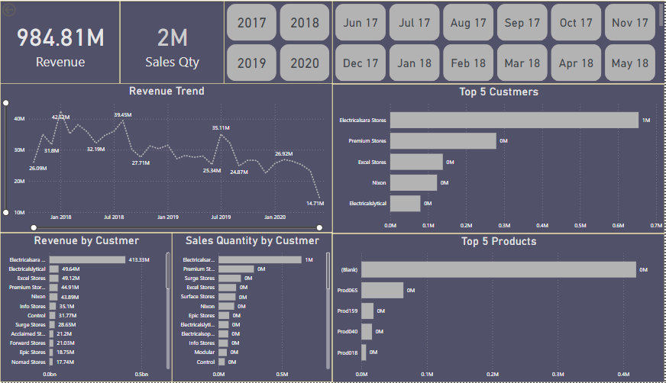
4. Dashboard Report Creation
AtliQ Hardware Sales Insights
Finally designed a Power BI dashboard using different visualizations i.e. Cards, Slicers, Line Chart and Stacked Bar Charts.
Dharmindar Ram Linkedin Portfolio Github E-mail

Slide 18
Project Insights:
AtliQ Hardware Sales Insights
2018 is the leading year by revenue
In 2018, 1.002284 million(leading) products were sold
Delhi NCR is the leading market by revenue of 520.72m
Identified top profitable markets by sales
Analysed total sales
Unveiled top 5 products driving most sales
Unveiled top 5 customers contributing to most sales
Segmented sales analysis for a comprehensive view
Dharmindar Ram Linkedin Portfolio Github E-mail

Slide 19
Project Findings:
AtliQ Hardware Sales Insights
Unveiled top performing products, top contributing customers, top markets by sales and revenue trends by single months to help business grow more and increase sales.
Dharmindar Ram Linkedin Portfolio Github E-mail

Slide 20

DHARMINDAR RAM
Data Enthusiast | ML Engineer | Data Analyst
Linkedin Portfolio Github E-mail

